Slide 1

Free Your Voice
Michele Zirkle

Slide 2

TIRED OF THIS?

Slide 3
TIRED OF YOUR MAN...
Telling jokes at your expense and making you feel helpless or humiliated?
Interrupting you and talking over you?
Making you feel exhausted after the most trivial of conversations?

Slide 4
DOES YOUR MAN...
Judge or criticize what you say/do?
Interrupt you mid-sentence or change the topic completely?
Tell you how you feel such as, “You always want to argue” or “You’re never happy?”

Slide 5

DOES HE...
Dismiss your concerns about topics
as if you have no right to your opinion?
Stop talking to you or withhold
affection when you speak your truth?

Slide 6
DOES YOUR MAN...
Accuse you of trying to make him mad?
Blame you for things you have no control over?
Talk to his mother disrespectfully like he talks to you?

Slide 7
Each of these behaviors is verbal abuse.
The more you answered “Yes,” the more control he has over you and the MORE
DESPERATE YOU MAY BE FOR A CHANGE.

Slide 8
I promise to show you:
How to recognize verbal abuse
How to know if your man is capable of changing
What you can do TO IMPROVE YOUR LIFE IMMEDIATELY!

Slide 9
WHY AM I MENTORING LADIES LIKE YOU?
It took me 22 years to realize I was in a verbally abusive marriage.
I don’t want it to take you that long!
I want to see you THRIVING, not just surviving.
BECAUSE Once you recognize the pattern, you have the power to change the entire dynamics of your relationship with yourself and others.

Slide 10

ARE YOU PRAYING HE WILL CHANGE?

Slide 11

ARE YOU CONFUSED AND TORMENTED because everything you’ve tried has failed?
Your answers are never intelligent enough and you’re never perfect enough to make him smile?

Slide 12

Do long to feel his his arms around you? Do you crave him staring into your eyes and really listening to you?
Do you want to talk at a level deeper than the kitchen sink?

Slide 13
My husband would kiss me on the way out the door in the morning and COME HOME 2 HOURS LATE AND SAY, “Can’t I even get a warm meal around here after working all day?”
He said I should just be glad he comes home every night.
I often wished he just wouldn’t come home.

Slide 14

As I shared tidbits from my day teaching,
He’d say how much more STRESSFUL HIS JOB WAS THAN MINE and how I had no idea what it was like to have a real job.

Slide 15
Sometimes I’d yell back, like when he’d say, “I can’t depend on you at all. All you have to do is just have your ass in the gym office for 3 hours till I get home.”
“I work full-time too!” I’d say. “It was your idea to open a gym. I don’t want to spend every spare moment inside those four walls.”

Slide 16

Sometimes I’d stop talking because I always said the wrong thing. I even stopped trying to get him to understand where I was coming from. I’d agree with anything he said so he’d stop shouting.
He’d say, “You’re so slow. Takes you four hours to clean the house. I could do it in 30 minutes.”
I’d slink off to do the dishes.

Slide 17

I WANTED
to swap stories of our day over dinner, but even the most trivial of conversations ended in accusations or put-downs. Sometimes he’d apologize or send flowers or slither up behind me and kiss me on the neck which I assumed was his way of saying he was sorry.

Slide 18
One evening after one of his outbursts he pulled me close. Instead of letting him kiss me I said, “If you want to apologize, I’m listening.”
His eyes bulged. “Apologize! For what?”

Slide 19

I managed to swallow and twist from his grasp.
IN THE PAST I’D REASONED IT WAS HIS WAY OF APOLOGIZING.

Slide 20
How do you know if your man can change?

Slide 21
A man is likely to change
IF HE:
Doesn’t mind you spending time with friends or family
Is okay with you having a career
Allows you to handle finances
Permits you to dress the way you like
Lets you come and go as you please
Isn’t physically violent

Slide 22

The real problem, you say is:
“My husband’s an asshole. He wants his way and doesn’t listen to my opinions.”

Slide 23
I GET IT!
I spent years trying to figure out what was wrong with me—why he was mad all the time.

Slide 24
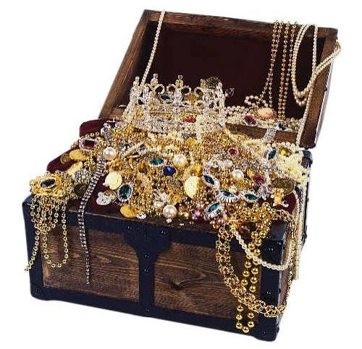
I tapped into my inner well of precious treasure and WOULD LOVE TO HELP YOU DISCOVER YOURS!

Slide 25

Insight #1
YOU’RE THE ONLY ONE WHO CAN SPEAK YOUR TRUTH!
Your man’s definition of you is not WHO YOU ARE.

Slide 26

Insight #2
You can NOT change your man.
You can ONLY CHANGE YOURSELF.
He will chose to change with you . . . or not.
Notes:
I WILL PROVIDE INSIGHTS EACH WEEK AS PART OF MY INTENSIVE PROGRAM

Slide 27

If you’re ready to pick up the shovel and get to work DIGGING OUT THE GOLD INSIDE OF YOU, then I’m willing to provide the map that will lead you to the buried treasure.
YOU HAVE A RIGHT TO IT! Don’t let your Blackbeard man steal it right from under your nose.

Slide 28

Your man has told you for long enough that you aren’t as important as he is. That nothing you do or say EVER will be more important than what he does and says. His job is more important. His mom is more important. His needs are more important.

Slide 29

Digging for the golden fountain inside you requires effort. If you’re willing to implement my suggestions and accept my guidance, I’ll funnel the energy your way that you need to get started and DIG TILL YOU FIND THE GOLDEN GODDESS LIVING INSIDE YOU!

Slide 30
It’s your time. You’re important.
Come home to yourself.
START BEING HAPPY RIGHT NOW!
HERE’S HOW:

Slide 31

DO WHAT YOU LOVE!
Make yourself smile! 😊

Slide 32

How do you cope when he verbally assaults you?
WHAT’S YOUR ESCAPE ACTIVITY?
Overeat, over exercise, over EVERYTHING
Immerse yourself in your kid’s activities
Indulge in alcohol
Shop till you drop
Read or watch TV
Go screw around -You’ll show HIM!

Slide 33
REPEAT THIS MANTRA:
“I want to escape this verbal abuse. I have a right to get away from it. I deserve to be treated with respect.”
Then: Immerse yourself in your PRE-DETERMINED ESCAPE ACTIVITY for at least 30 minutes. ENJOY YOUR ESCAPE.

Slide 34
I CAN SHOW YOU HOW TO . . .
Stop feeling like an old pair of shoes that have been tossed into the corner and forgotten.
Stop feeling sorry for him.
START FEELING MORE IMPORTANT than his stack of papers.

Slide 35

ARE YOU READY TO . . .
JUMP INTO A LASTING CHANGE?
FIND what makes you bubble joy from the inside out?

Slide 36
I can catapult you into the relationship you desire, with your man and yourself.

Slide 37
For 22 years, I didn’t realize what my husband was saying was actually abuse. I thought it was normal.
We’d always argued but I made every excuse for why I couldn’t seem to do anything right.

Slide 38
I’d make excuses for him.
He had a stressful workday.
He doesn't’ REALLY mean to hurt me. He LOVES ME.
I really was as slow/dumb/inept as he said.

Slide 39
DONE MAKING EXCUSES?
MY 8 WEEK PROGRAM teaches you how to communicate with your man in a way that will help him change.
MORE IMPORTANTLY, YOU’LL CHANGE—FROM THE INSIDE, OUT.

Slide 40
That’s why I’m offering you
ONE FREE CONSULTATION NOW!
Click Here To Register

Slide 41

WHEN YOU WORK WITH ME...
You’ll find YOUR INNER GODDESS.
You’ll feel
well-rooted,
inspired and
JOYOUS!

Slide 42

Sweetheart, IF YOU’RE LOOKING for a new approach to life--one that will
allow your joy to bubble into
everything you do and into
everyone you meet,
I’M THE MENTOR FOR YOU!
I’LL HELP YOU FIND YOUR VOICE--the one your man has squashed for the last time!

Slide 43
ARE YOU READY FOR A REAL CHANGE THAT STICKS?
ARE YOU READY TO STOP THE CYCLE OF ABUSE AND BE
FREE TO SPEAK?

Slide 44

I developed this 8-week course packed full of insights I’ve gained by working with a master life coach for OVER 6 YEARS.
I KNOW MY PROGRAM WORKS.
I’M LIVING PROOF!

Slide 45
I CHANGED MY LIFE.
YOU CAN, TOO!

Slide 46
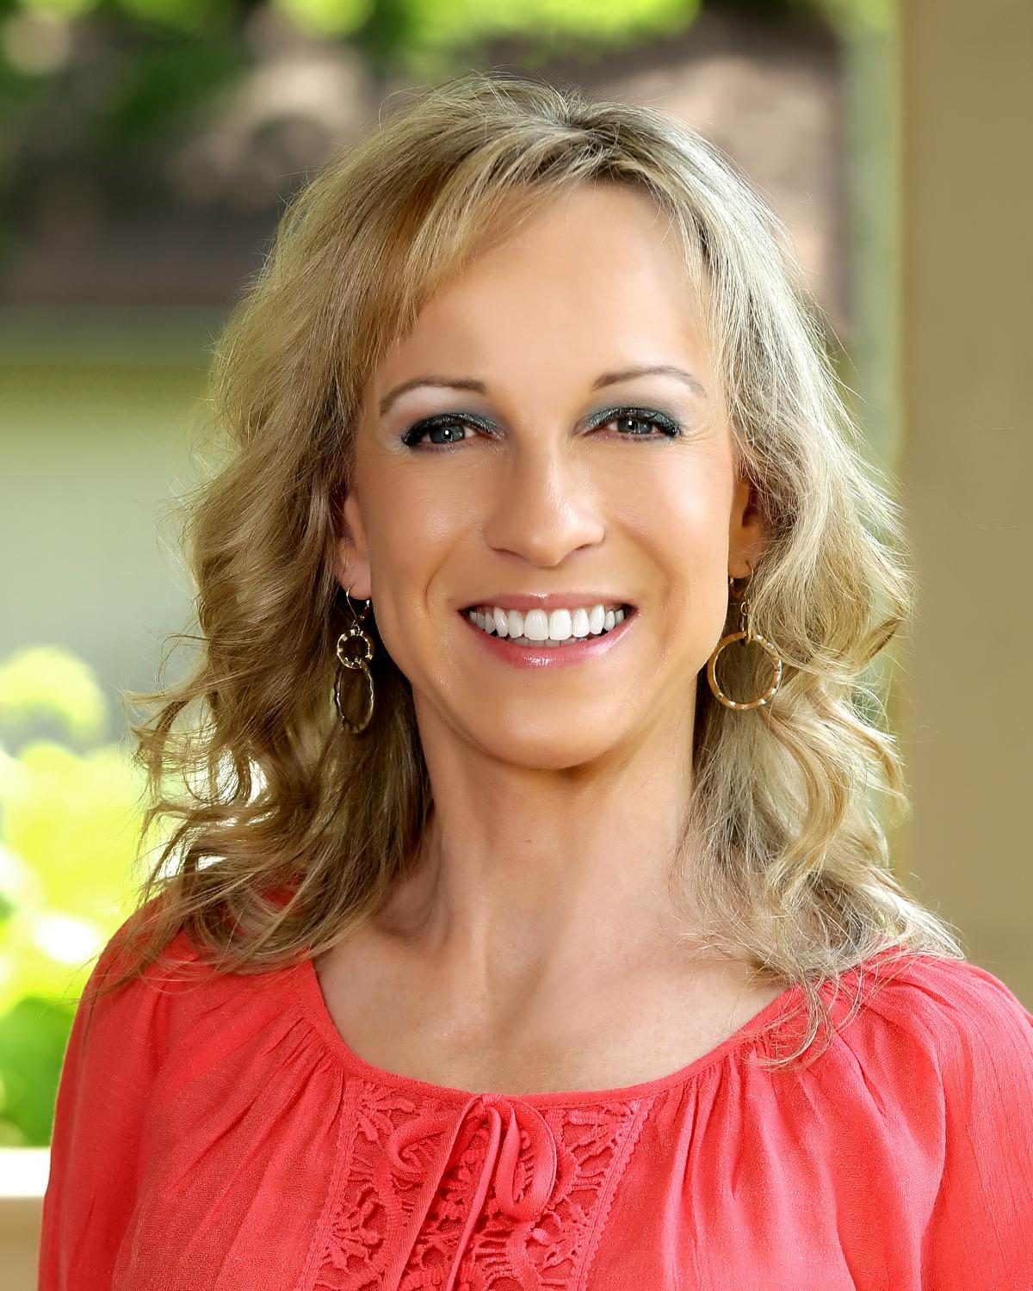
MAKE THE CHANGE TODAY!
CLICK HERE FOR YOUR FREE 50-MINUTE CONSULTATION

Slide 47
YOU HAVE TREASURES WAITING TO BE UNLOCKED. I HAVE THE KEYS!
I can teach you how to BE FREE TO SPEAK; FREE to breathe and play and live safe knowing that your thoughts and words are valuable.

Slide 48




I’d love to hear what your Escape Activity is
and how it helps you!
Search “Verbal Abuse Mentor”
Michele Savaunah Zirkle Marcum
@verbalabusementor
VerbalAbuseMentor.com

Slide 49


Want to learn more?
Sign up for my FREE three-day email training program.
Schedule your FREE CONSULT today!

Slide 50

One more thing...
TAKE this quick survey TO SEE IF YOU QUALIFY FOR MY PROGRAM,
FREE TO SPEAK

